Slide 1
AI vs Intelligence in Rail Guns
Evan Keller

Slide 2
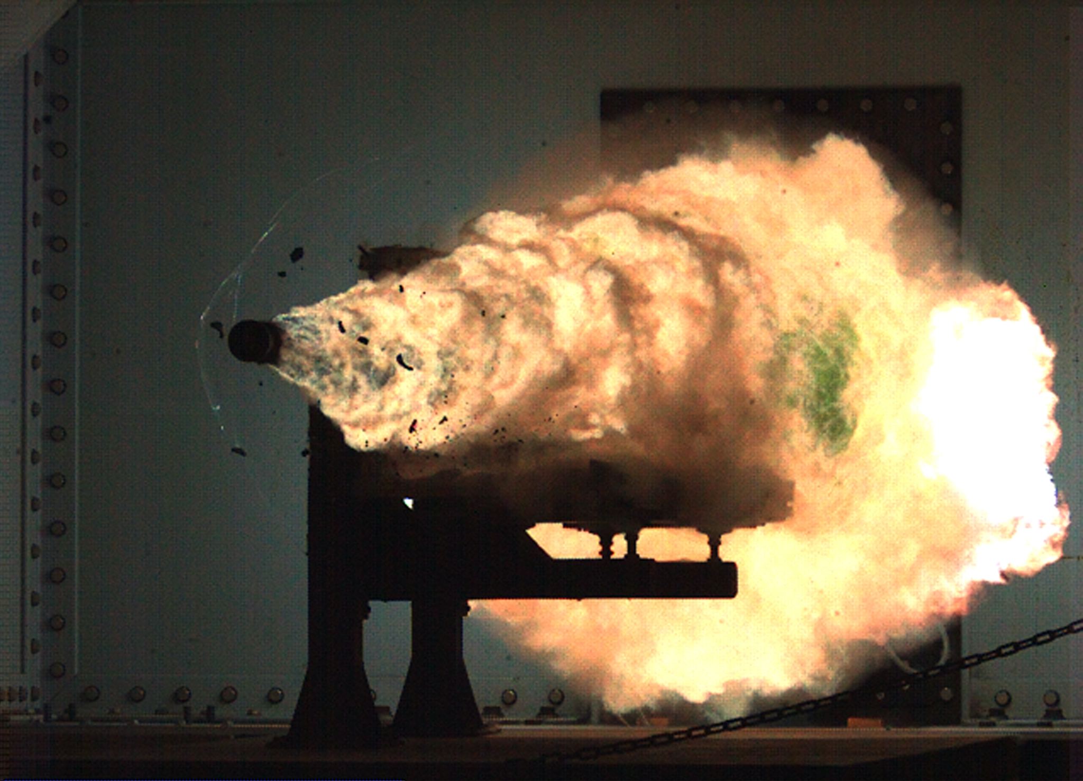
Overview
History
Plan and Implementation (Mechanics)
Plan and Implementation (Uses)
Railgun concepts
Upsides of the Advancement
Statistics Graph
Downsides of the Advancement
Summary
References
Railgun Testing by the US Navy

Slide 3
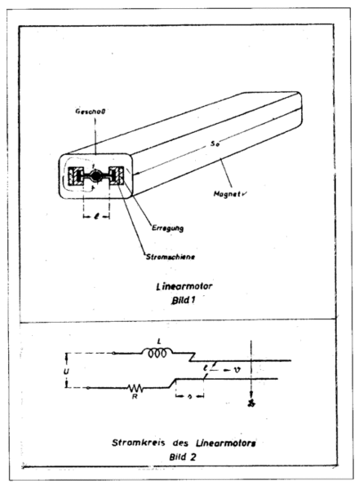
History
First concept created in 1918
Louis Octave Fauchon-Villeplee made the “Electric Apparatus for Propelling Projectiles”
Later developed by Germany's ordnance office in WW2 (see image)
Main advancements done by the US Navy starting in 2005
Notes:
Louis Octave Fauchon-Villeplee created the first concept of a railgun in 1918. His invention used electricity to propel a projectile, but was very basic and required a lot of energy. He later got a US patent for this, but development continued when Germans during the second world war continued to research it, trying to improve the design. What is known as a railgun was actually truly developed starting in 2005 when the US Navy started a project on it. They wanted to created an operational railgun that could be used to defend Navy ships against hypersonic missiles.
https://nationalinterest.org/blog/buzz/railguns-everything-you-always-wanted-know-168479
http://mymechatronics.pbworks.com/w/page/21973487/Railgun

Slide 4
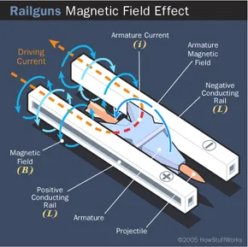
Plan and Implementation Mechanics
A railgun fires a projectile using electricity and conductive rails
Energy is sent through the rails, creating an electromagnetic field
Projectile is accelerated by the field, launching out of the rails
Longer rails and more power=higher projectile velocity
Notes:
A railgun operates using electromagnetic fields. When energy is run through a conductive substance, an electromagnetic field is produced. This is utilized by sending massive amounts of energy down two rails, and the resulting field accelerates the projectile away from the power source (down the barrel). The acceleration and velocity of the projectile can be adjusted by changing the length of the rails and the amount of power used.
https://science.howstuffworks.com/rail-gun1.htm

Slide 5
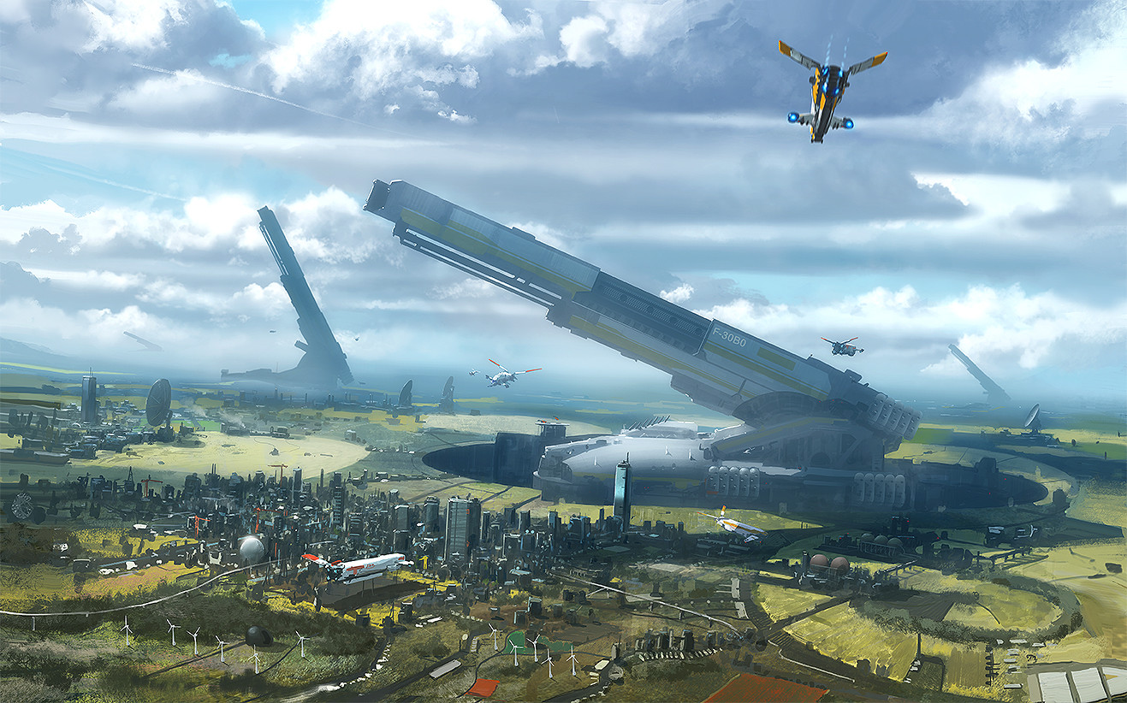
Plan and Implementation
The railgun would be used on military ships for defence
Projectiles would be fired at cruise missiles or enemy aircraft to defend the ship
Larger scale railguns could be used for planetary defence
Used in modern warfare/future wars
Uses
The Who and What
Concept art for large-scale railguns
Notes:
The railgun would be implemented into modern warfare if it is ever completed. It could be built into military ships and used to defend the ships from aircraft (AA) or hypersonic cruise missiles. Additionally, the railgun could be used to bombard land targets like enemy military bases. Some people have theorized that railguns on a massive scale could actually be used for planetary defence, in which they fire large projectiles at asteroids to redirect them.
https://nationalinterest.org/blog/buzz/railguns-everything-you-always-wanted-know-168479
https://learningenglish.voanews.com/a/us-navy-cancels-development-of-high-tech-railgun-weapon/5951475.html

Slide 6
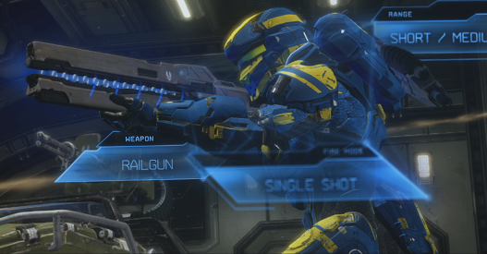
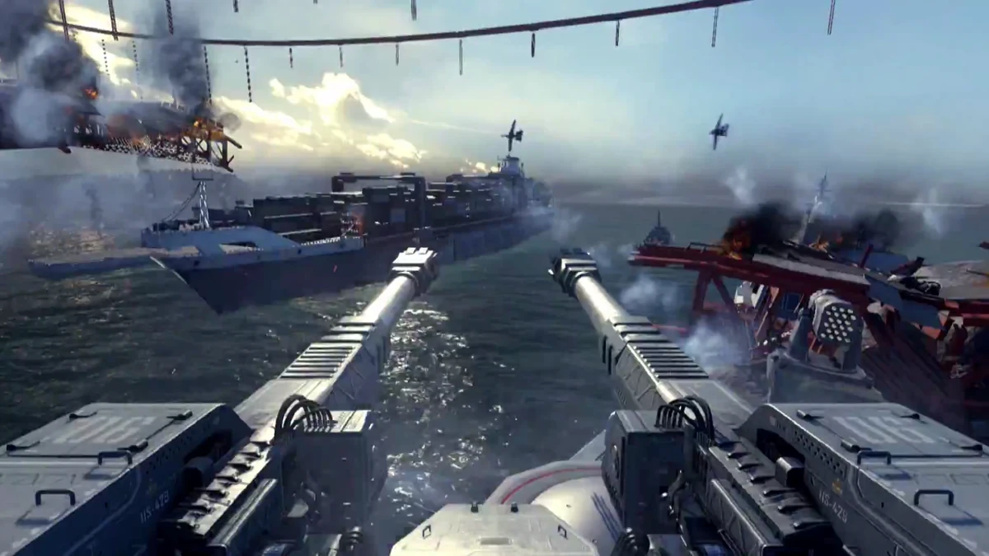
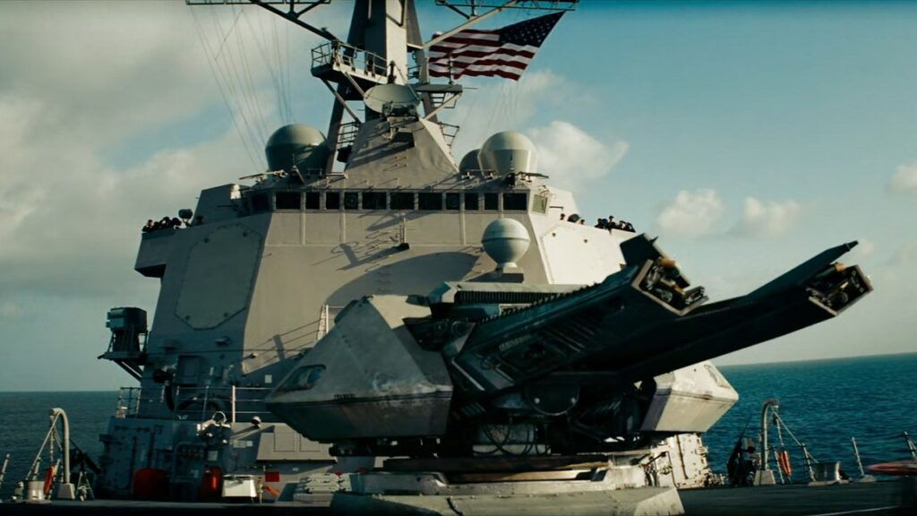
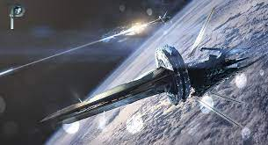
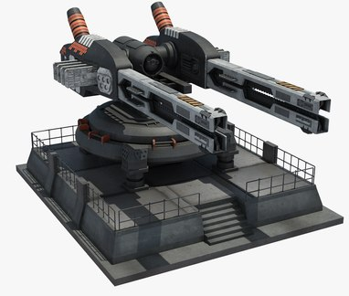
Railgun Concepts
Railguns are a popular concepts in Sci-Fi video games and movies
These are some examples
Notes:
Examples of hypothetical railguns portrayed in digital media

Slide 7
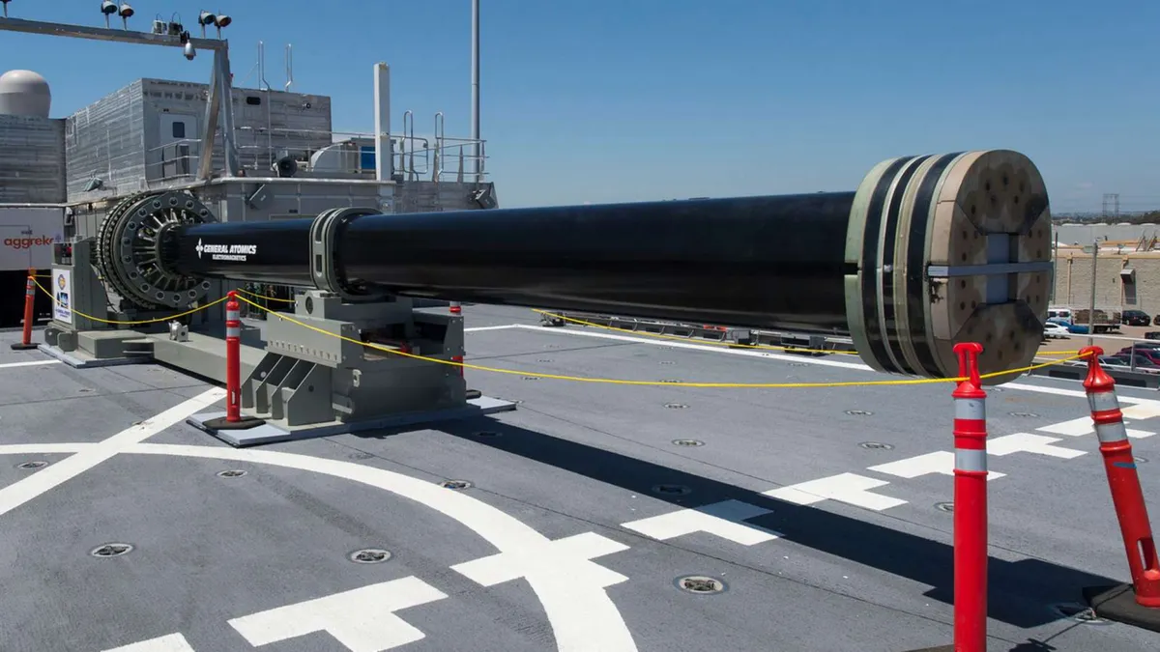
Pros vs Cons
of Railguns
Railgun projectiles would achieve higher speeds than standard cannon projectiles
Over mach 6 speed and 126 mile range
High velocity of projectiles means explosives aren’t necessary
Pros
A railgun prototype on the USS Millinocket
Notes:
The railgun, if implemented, would have many potential benefits. Mainly, this has to do with its capabilities. Railguns would be able to fire projectiles much faster than traditional cannons like the 16 in Mark 7 cannon, which is common on US battleships. The projectiles would travel faster than mach 6, around 5,400 miles per hour, with an effective range of about 126 miles. Higher speeds also means better accuracy at longer ranges. It also means that the projectiles have so much kinetic energy that explosive rounds aren’t necessary, the force generated from the impact will destroy anything it hits. A lack of explosive inside the projectile also reduces their cost, making the railgun more practical.

Slide 8
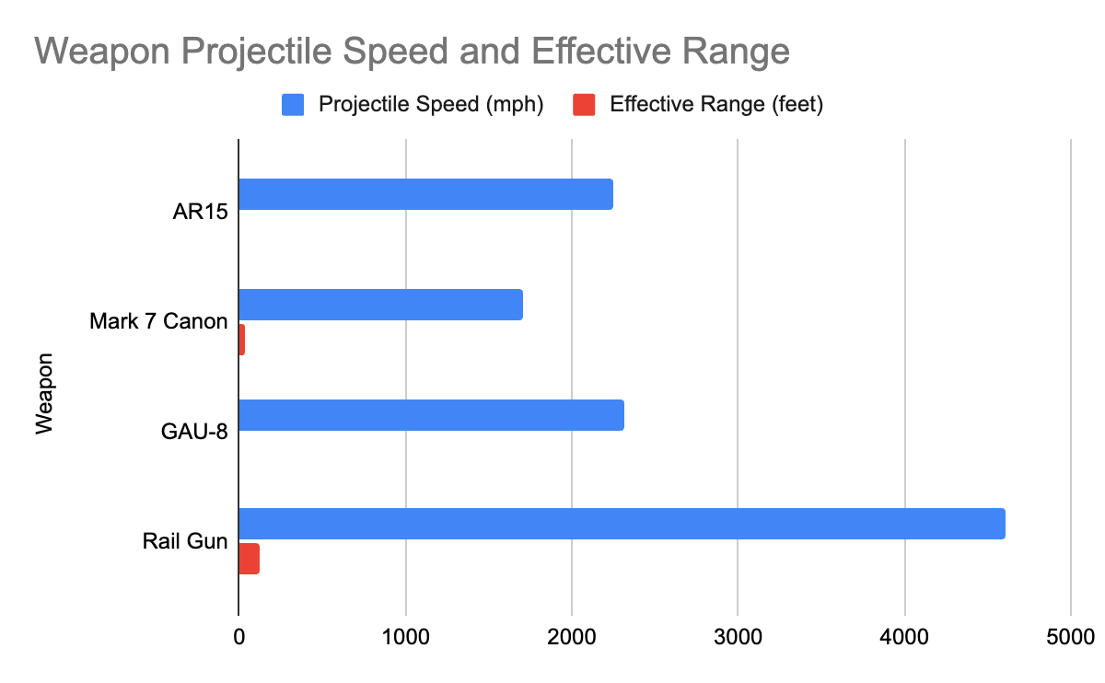
Graph of Railgun Statistics Compared to Other Conventional Cannons

Slide 9
Pros vs Cons
of Railguns
Railguns are still in development- haven’t been completed
Massive amount of energy needed to operate
Railguns can’t sustain constant use
Can only be used near a power supply
Cons
Notes:
While railguns would have several advantages over other weapons, they also have many issues preventing them from being built and implemented. This is due to the requirements of the railgun. It hasn’t been completely developed yet, so there are still lots of issues. These include the massive amount of energy that the railgun needs to fire projectiles, which also means that they can only be built/used next to a large power supply like a ship with a nuclear reactor. Along with this, firing the railgun causes damage to it’s internal machinery, so the parts have to be constantly replaced.

Slide 10
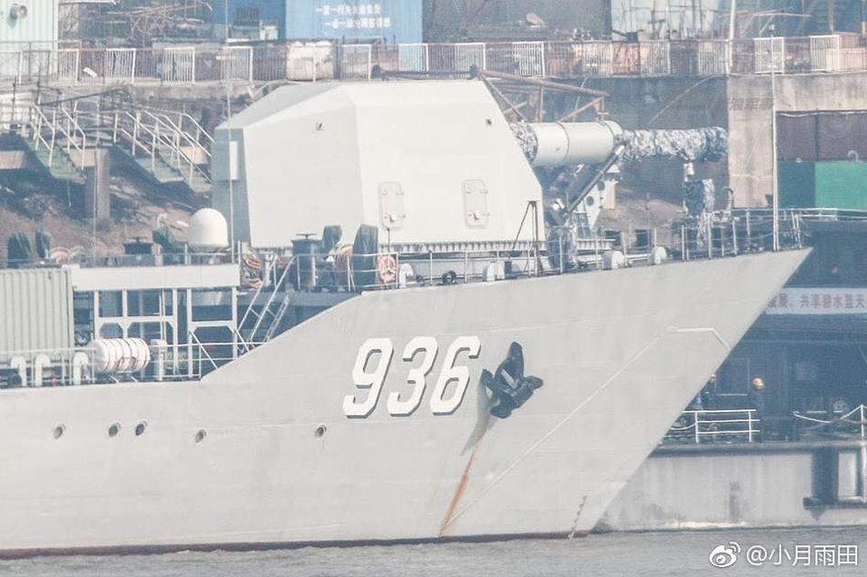
I support the advancement/development of railguns
They have potential use by the US military
Could be used to help maintain peace in the world
Chinese railgun prototype on the ship Haiyang Shan
Summary
Notes:
Overall, I am for the development of railguns. In my opinion, they have potential in use by the US Military, and could be a strategic weapon used in future wars. I think that if they were implemented, they could give an advantage to US ships in maintaining control and naval superiority. While some may argue that the development of new and better weapons only leads to more destruction and death in war, it seems necessary and could be useful in maintaining peace.

Slide 11
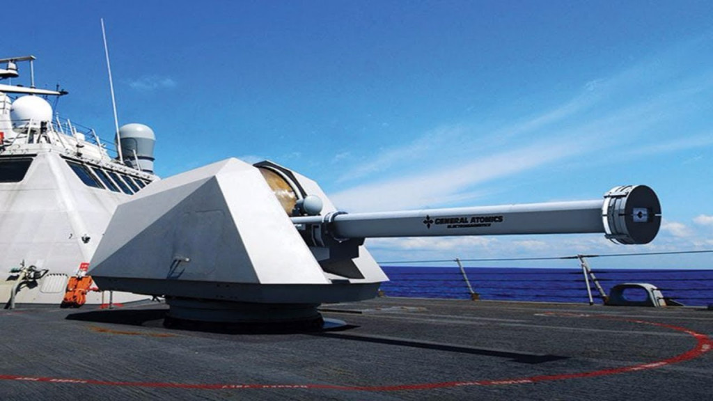
References
Railguns: Everything You Always Wanted to Know
Railgun- Mechatronics
US Navy Cancels Development of High-Tech Railgun Weapon
Rail Gun Basics
Ins and outs of railguns: Will they eventually see widespread usage?
A US Navy railgun prototype
Notes:
These are my sources for the assignment, specifically without referencing wikipedia.

